Slide 1
Use case Testing
Use cases are one way of specifying functionality as business scenarios or process flows.
They capture the individual interactions between ‘actors’ and the system.
An actor represents a particular type of user and the use cases capture the interactions that each user takes part in to produce some output that is of value.
Test cases based on use cases at the business process level, often called scenarios, are particularly useful in exercising business rules or process flows and will often identify gaps or weaknesses in these that would not be found by exercising individual components in isolation.
This makes use case testing very effective in defining acceptance tests because the use cases represent actual likely use.

Slide 2
Use case Testing
Use cases may also be defined at the system level, with preconditions that define the state the system needs to be in on entry to a use case to enable the use case to complete successfully, and post conditions that define the state of the system on completion of the use case.
Use cases typically have a mainstream path, defining the expected behaviour, and one or more alternative paths related to such aspects as error conditions. Well defined use cases can therefore be an excellent basis for system level testing, and they can also help to uncover integration defects caused by incorrect interaction or communication between components.
In practice, writing a test case to represent each use case is often a good starting point for testing, and use case testing can be combined with other specification based testing.

Slide 3
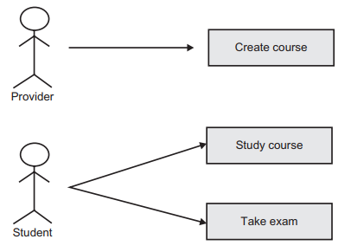
Use case example 1
In a use case diagram each type of user is known as an actor, and an actor stands for all users of the type. Use cases are activities carried out for that actor by the system.
This is, in effect, a high-level view of requirements.
The diagram alone does not provide enough detail for testing, so we need some textual description of the processes involved as well.
Use case testing has the major benefit that it relates to real user processes, so it offers an opportunity to exercise a complete process flow.
The principles applied elsewhere can be applied here: first test the highest priority (highest value) use cases by taking typical examples; then exercise some attempts at incorrect process flows; and then exercise the boundaries.

Slide 4
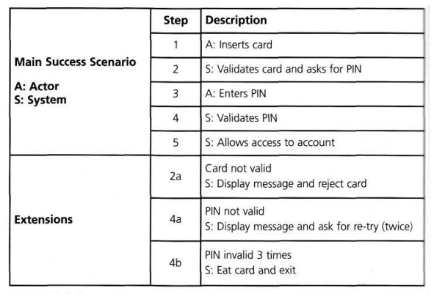
Use case example 2
System requirements can also be specified as a set of use cases.
This approach can make it easier to involve the users in the requirements gathering and definition process.
ATM cash withdrawal:

